Slide 1
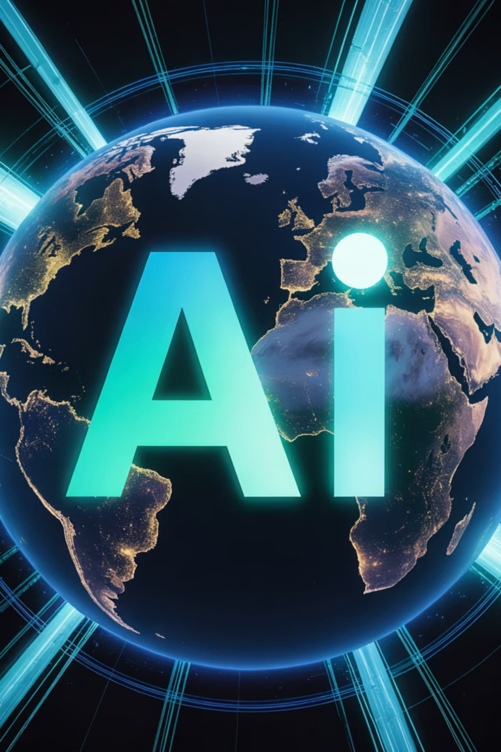
AI Innovation for the Future

Slide 2
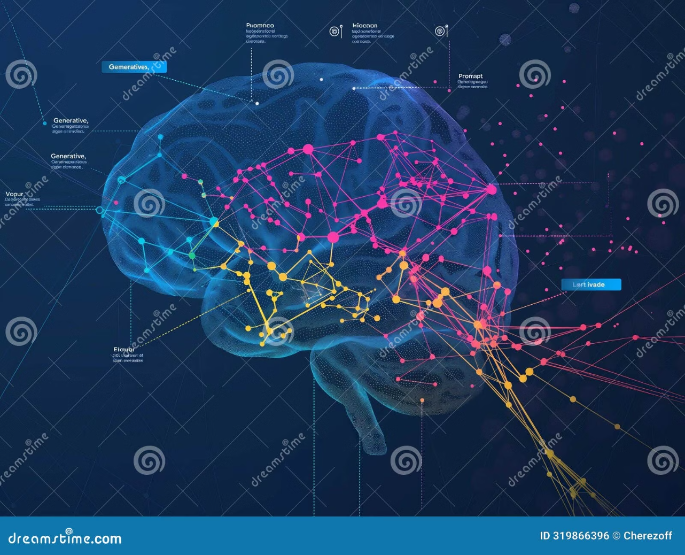
What is Artificial Intelligence?
Artificial Intelligence (AI) is the science and engineering of making intelligent machines, especially intelligent computer programs. In essence, it is about enabling computers to perform tasks that typically require human intelligence, such as learning, decision-making, perception, and problem-solving.
AI is the operating system of our future, driving unprecedented transformations across every sector.

Slide 3
AI Evolution: From Logic to Creativity
1950s-1970s: Rule-Based Systems
2010s: Deep Learning Revolution
Early AI focused on hard-coded logic and expert systems. Machines could solve specific, defined problems, but lacked flexibility.
Complex algorithms and massive computing power unlocked true pattern recognition, powering advances in image and speech recognition.
1
2
3
4
1980s-2000s: Machine Learning
Present: Generative AI
The rise of statistical methods and algorithms allowed machines to learn from data (e.g., neural networks, decision trees).
Models like Transformers create novel content (text, images, code) rather than just classifying or predicting existing data.

Slide 4
Frontiers of Now: Current AI Innovations
AI is moving beyond the lab and into mainstream applications that are redefining productivity and daily life.
Generative LLMs (ChatGPT)
Autonomous Transportation
Advanced Robotics
Healthcare Diagnostics
AI-driven robots performing complex, collaborative tasks in manufacturing and surgical theaters.
Revolutionizing communication, research, and creative content generation.
Advanced vision systems and decision engines enabling self-driving cars and optimized logistics.
Accelerated diagnosis, personalized treatment plans, and drug discovery optimization.

Slide 5










AI-Powered Possibilities: The World of Tomorrow
AI will be instrumental in solving the grand challenges of our era and achieving unprecedented levels of human flourishing.
Sustainable Cities
Space Exploration
Optimizing energy grids, traffic flow, and waste management systems.
Autonomous mission control and deep space data processing.
Personalized Education
Adaptive learning platforms tailored to individual student needs and pace.
Climate Modeling
Highly accurate prediction and mitigation strategies for environmental crises.
Longevity and Health
Predictive medicine and customized wellness interventions.

Slide 6
Navigating the Ethical and Social Impact of AI
The acceleration of AI technology demands proactive consideration of its societal implications.
Algorithmic Bias
Data Privacy & Security
Ensuring fairness and preventing AI models from perpetuating or amplifying existing societal prejudices.
Protecting vast amounts of personal and proprietary data used to train and operate intelligent systems.
Job Transformation
Accountability and Governance
Addressing the need for upskilling and retooling the workforce as AI automates routine tasks.
Establishing clear legal and ethical frameworks for AI decision-making, especially in high-stakes environments.

Slide 7
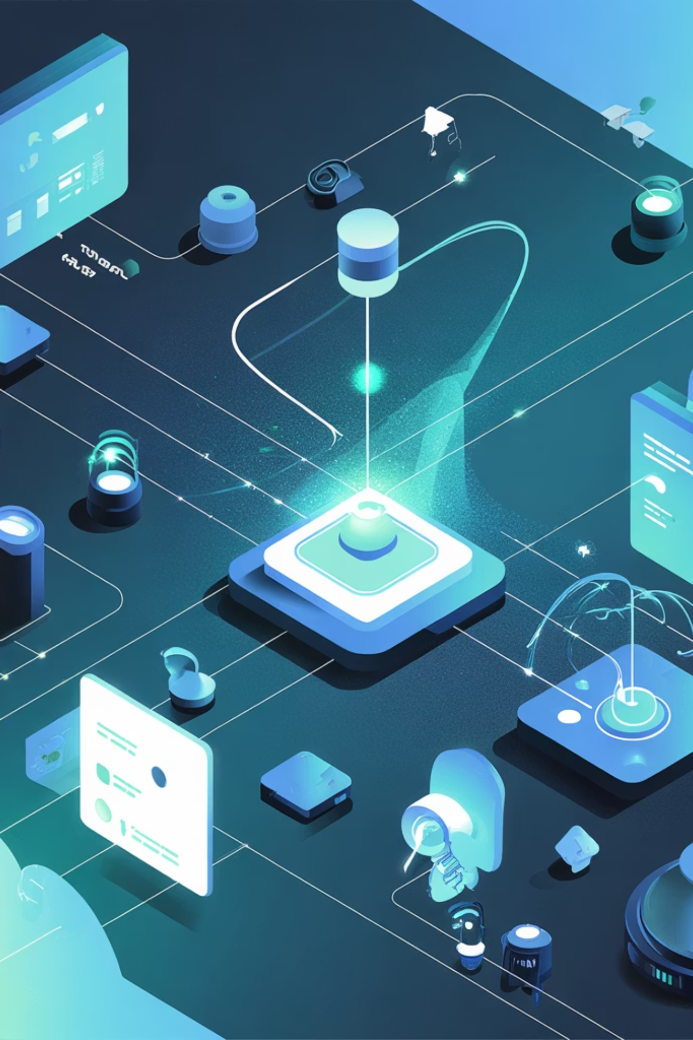
IoT Fundamentals: The Connected Intelligence Revolution
The Internet of Things (IoT) combined with Artificial Intelligence creates an ecosystem where devices don't just collect data, but also intelligently act upon it, transforming industries and daily life. This integration forms the backbone of a new era of connected intelligence.

Slide 8
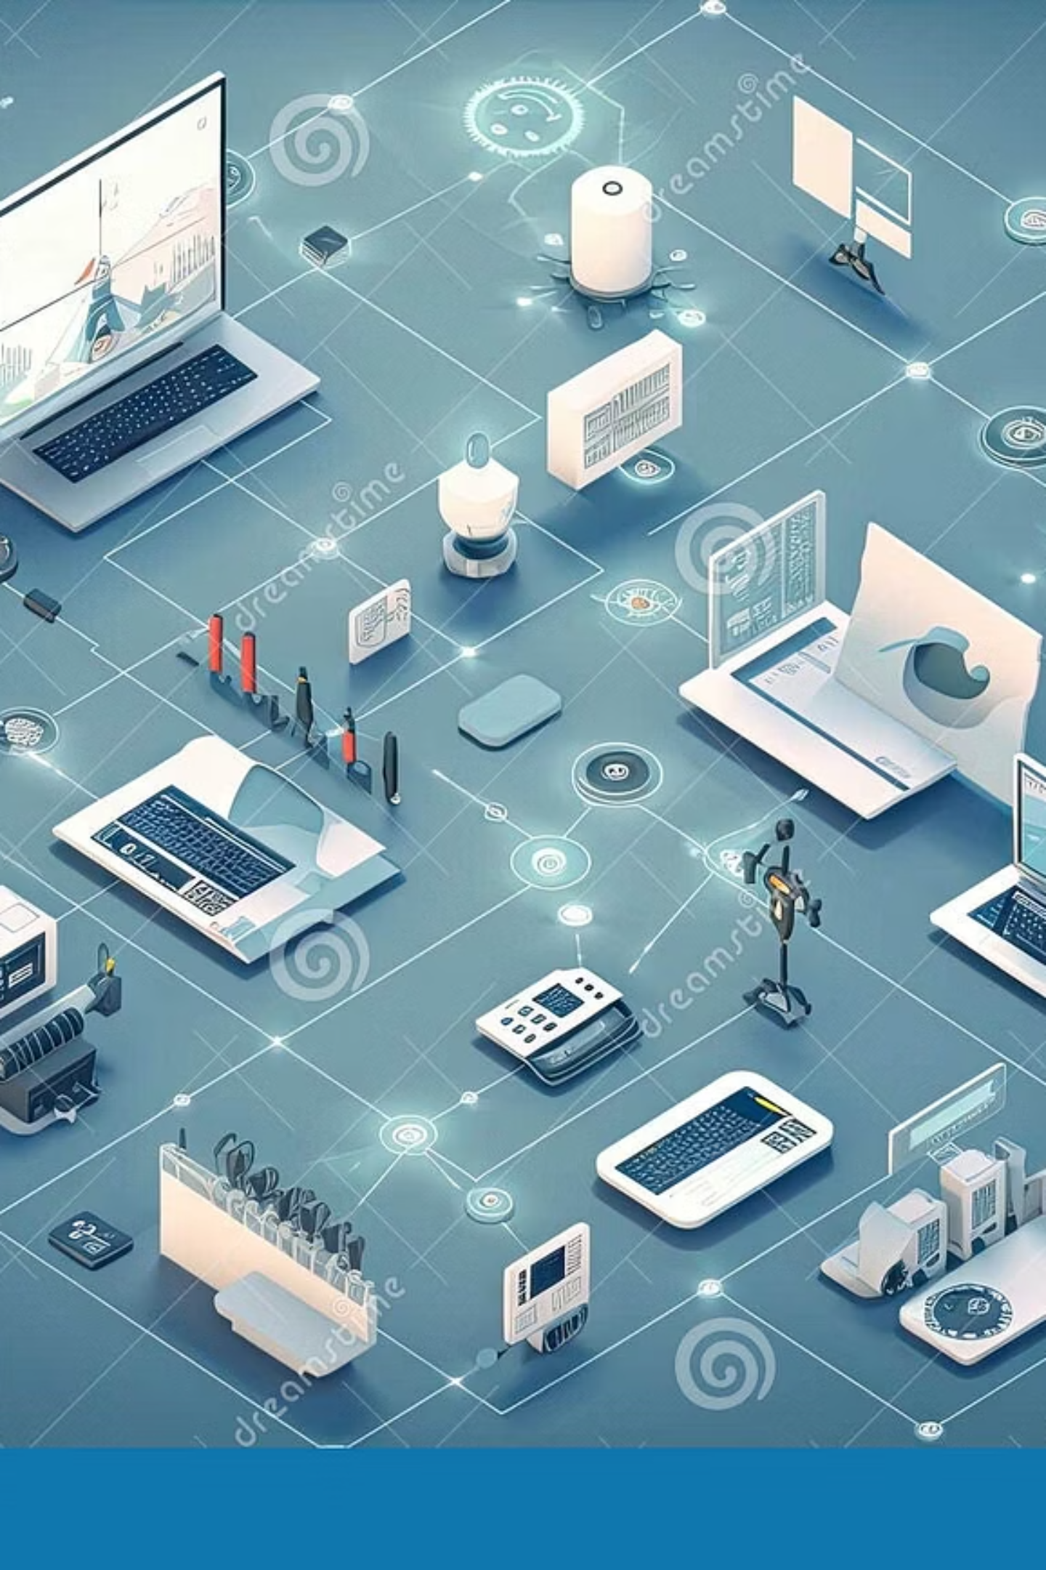


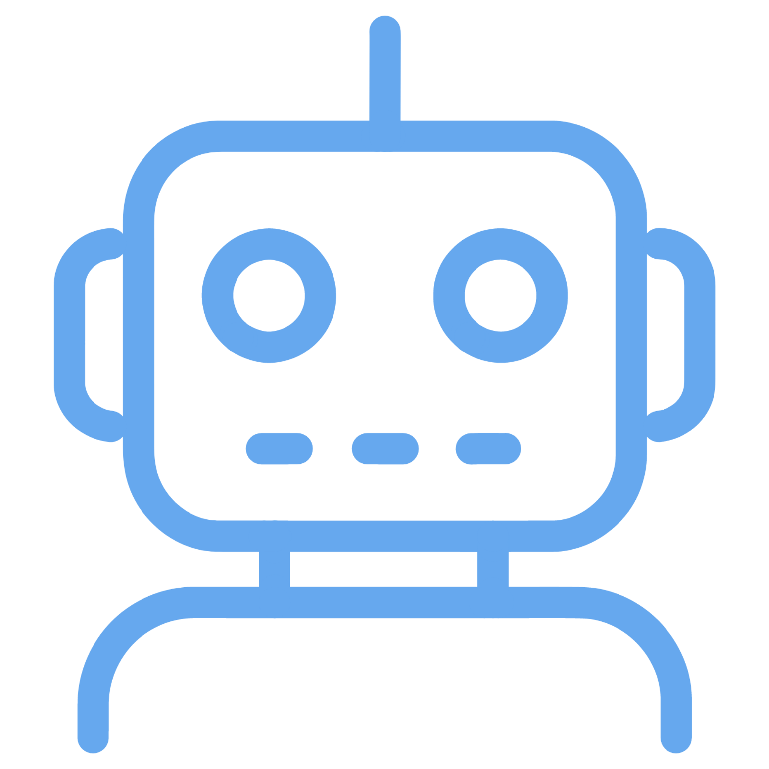
IoT Applications: Smart Infrastructure
The Internet of Things (IoT) isn't just a concept; it's driving tangible transformations across urban infrastructure and public services, enhancing efficiency, safety, and convenience through real-world applications.
Smart Cities
Optimizing urban infrastructure from traffic management to public safety and energy conservation.
Connected Health
Enabling remote patient monitoring, personalized treatment, and proactive health interventions.
Autonomous Systems
Powering self-driving vehicles, drones, and automated industrial processes for greater precision.

Slide 9
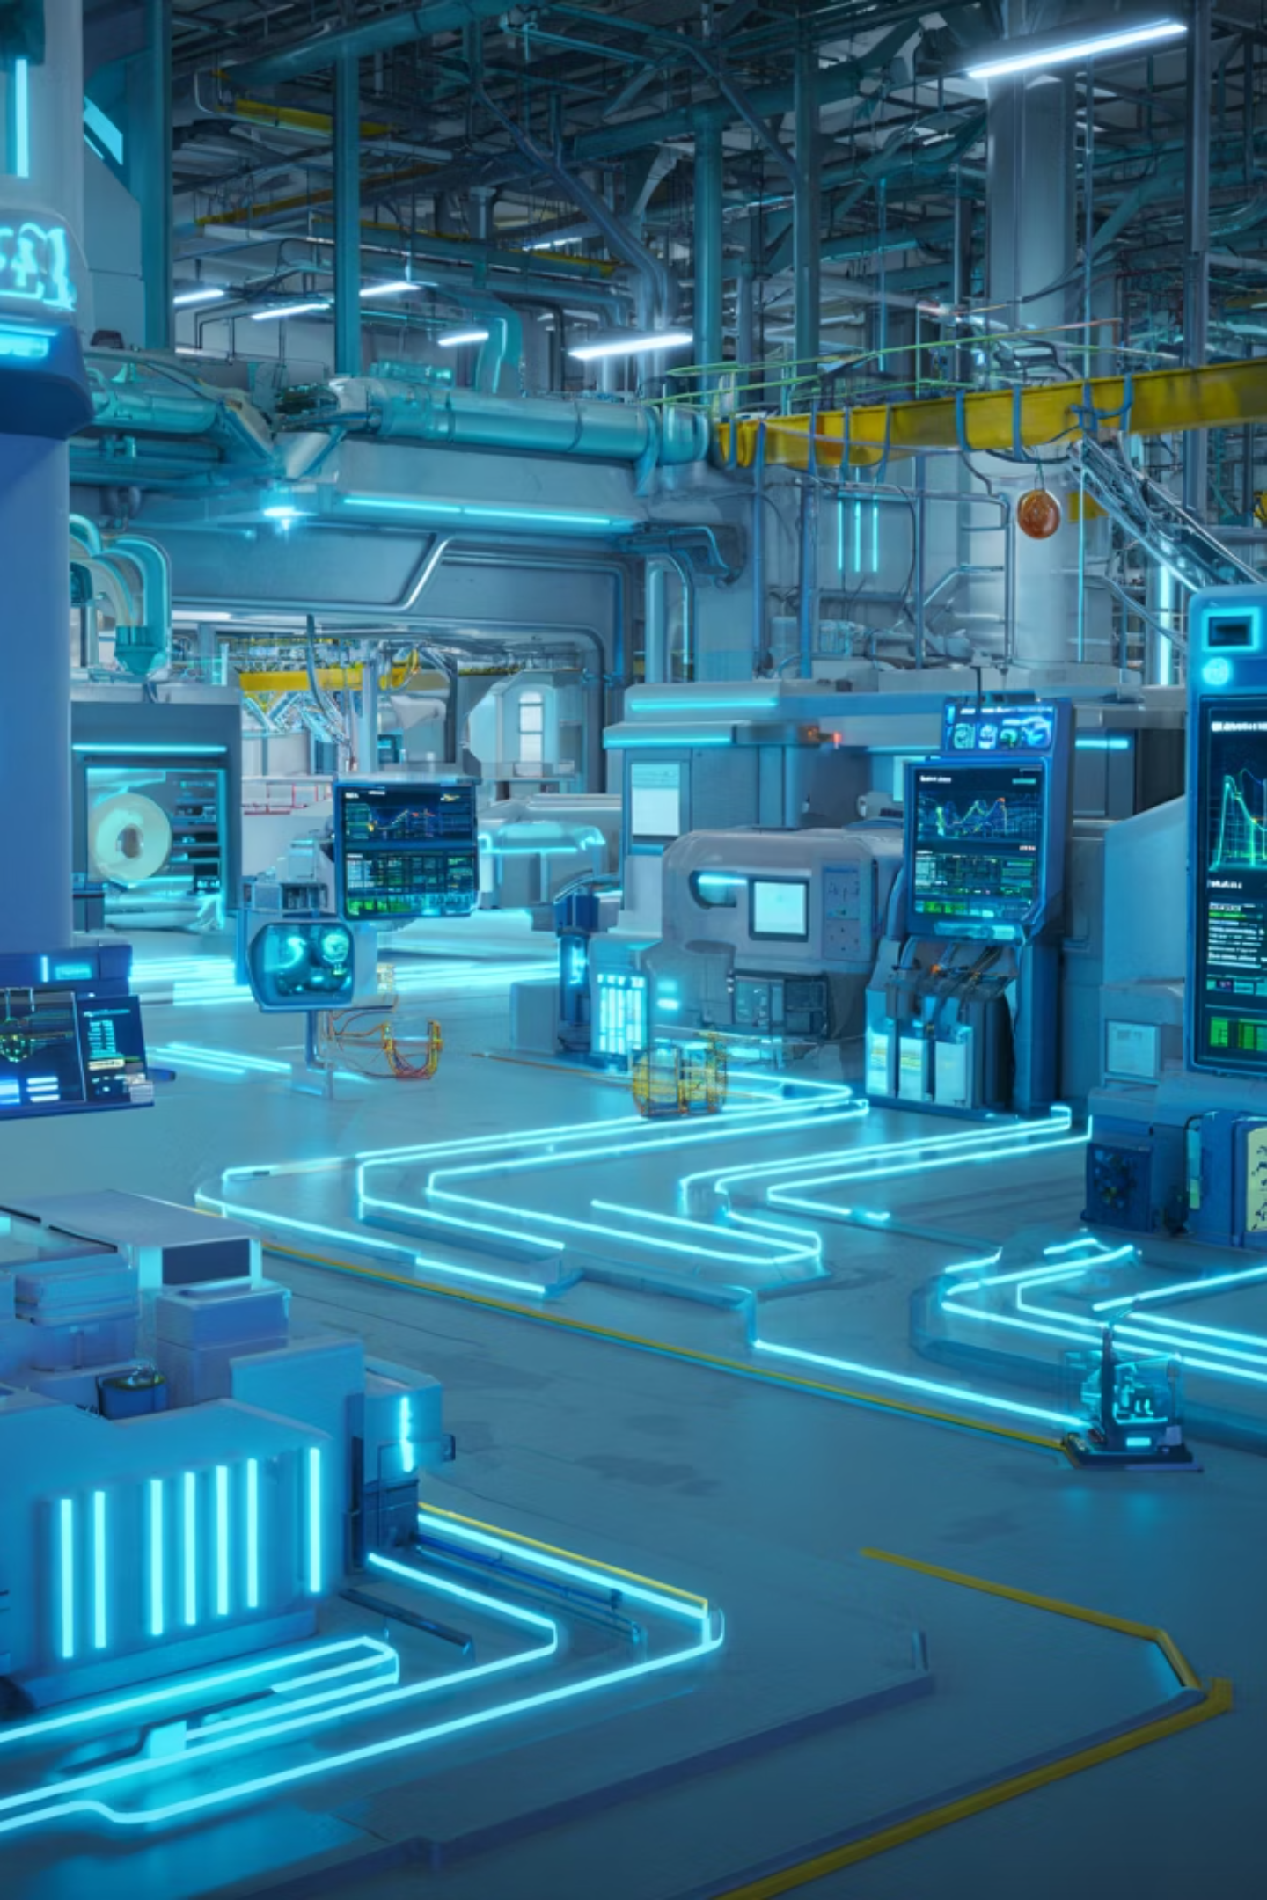






IoT Applications: Industrial & Personal Solutions
Beyond public infrastructure, IoT is revolutionizing operational efficiency in industries and enhancing convenience in personal environments by creating smarter, more responsive systems.
Predictive Maintenance
Real-time Processing
IoT sensors monitor equipment health in real-time, predicting potential failures before they occur. This minimizes costly downtime and optimizes operational schedules in manufacturing.
Immediate data analysis from connected devices enables instant decision-making. This improves efficiency in supply chain logistics and allows for rapid adjustments in dynamic environments.
Intelligent Devices
From smart thermostats adjusting to weather patterns to automated security systems, IoT devices integrate seamlessly into daily life, offering personalized control and enhanced comfort.

Slide 10
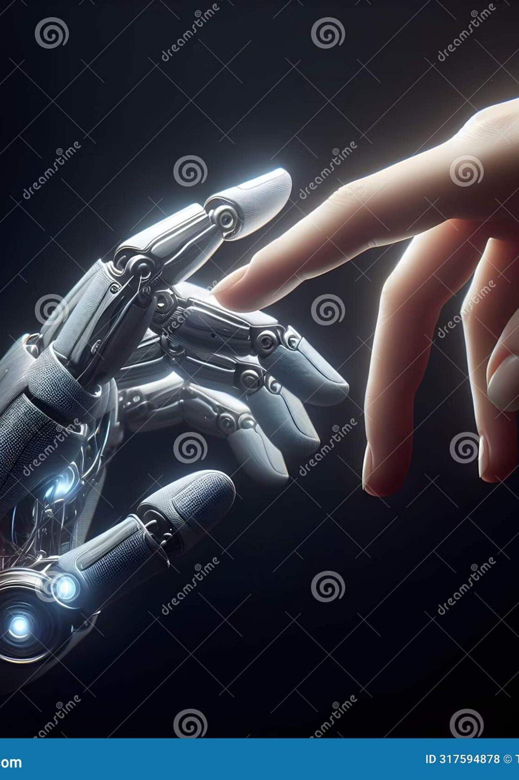
A Future of Collaboration
The ultimate potential of AI is not replacement, but enhancement. We are entering an era where the collaboration between human creativity and machine intelligence will unlock the next golden age of innovation.
The future of humanity with AI is a partnership—machines handling complexity, humans focusing on purpose and passion.

Slide 11
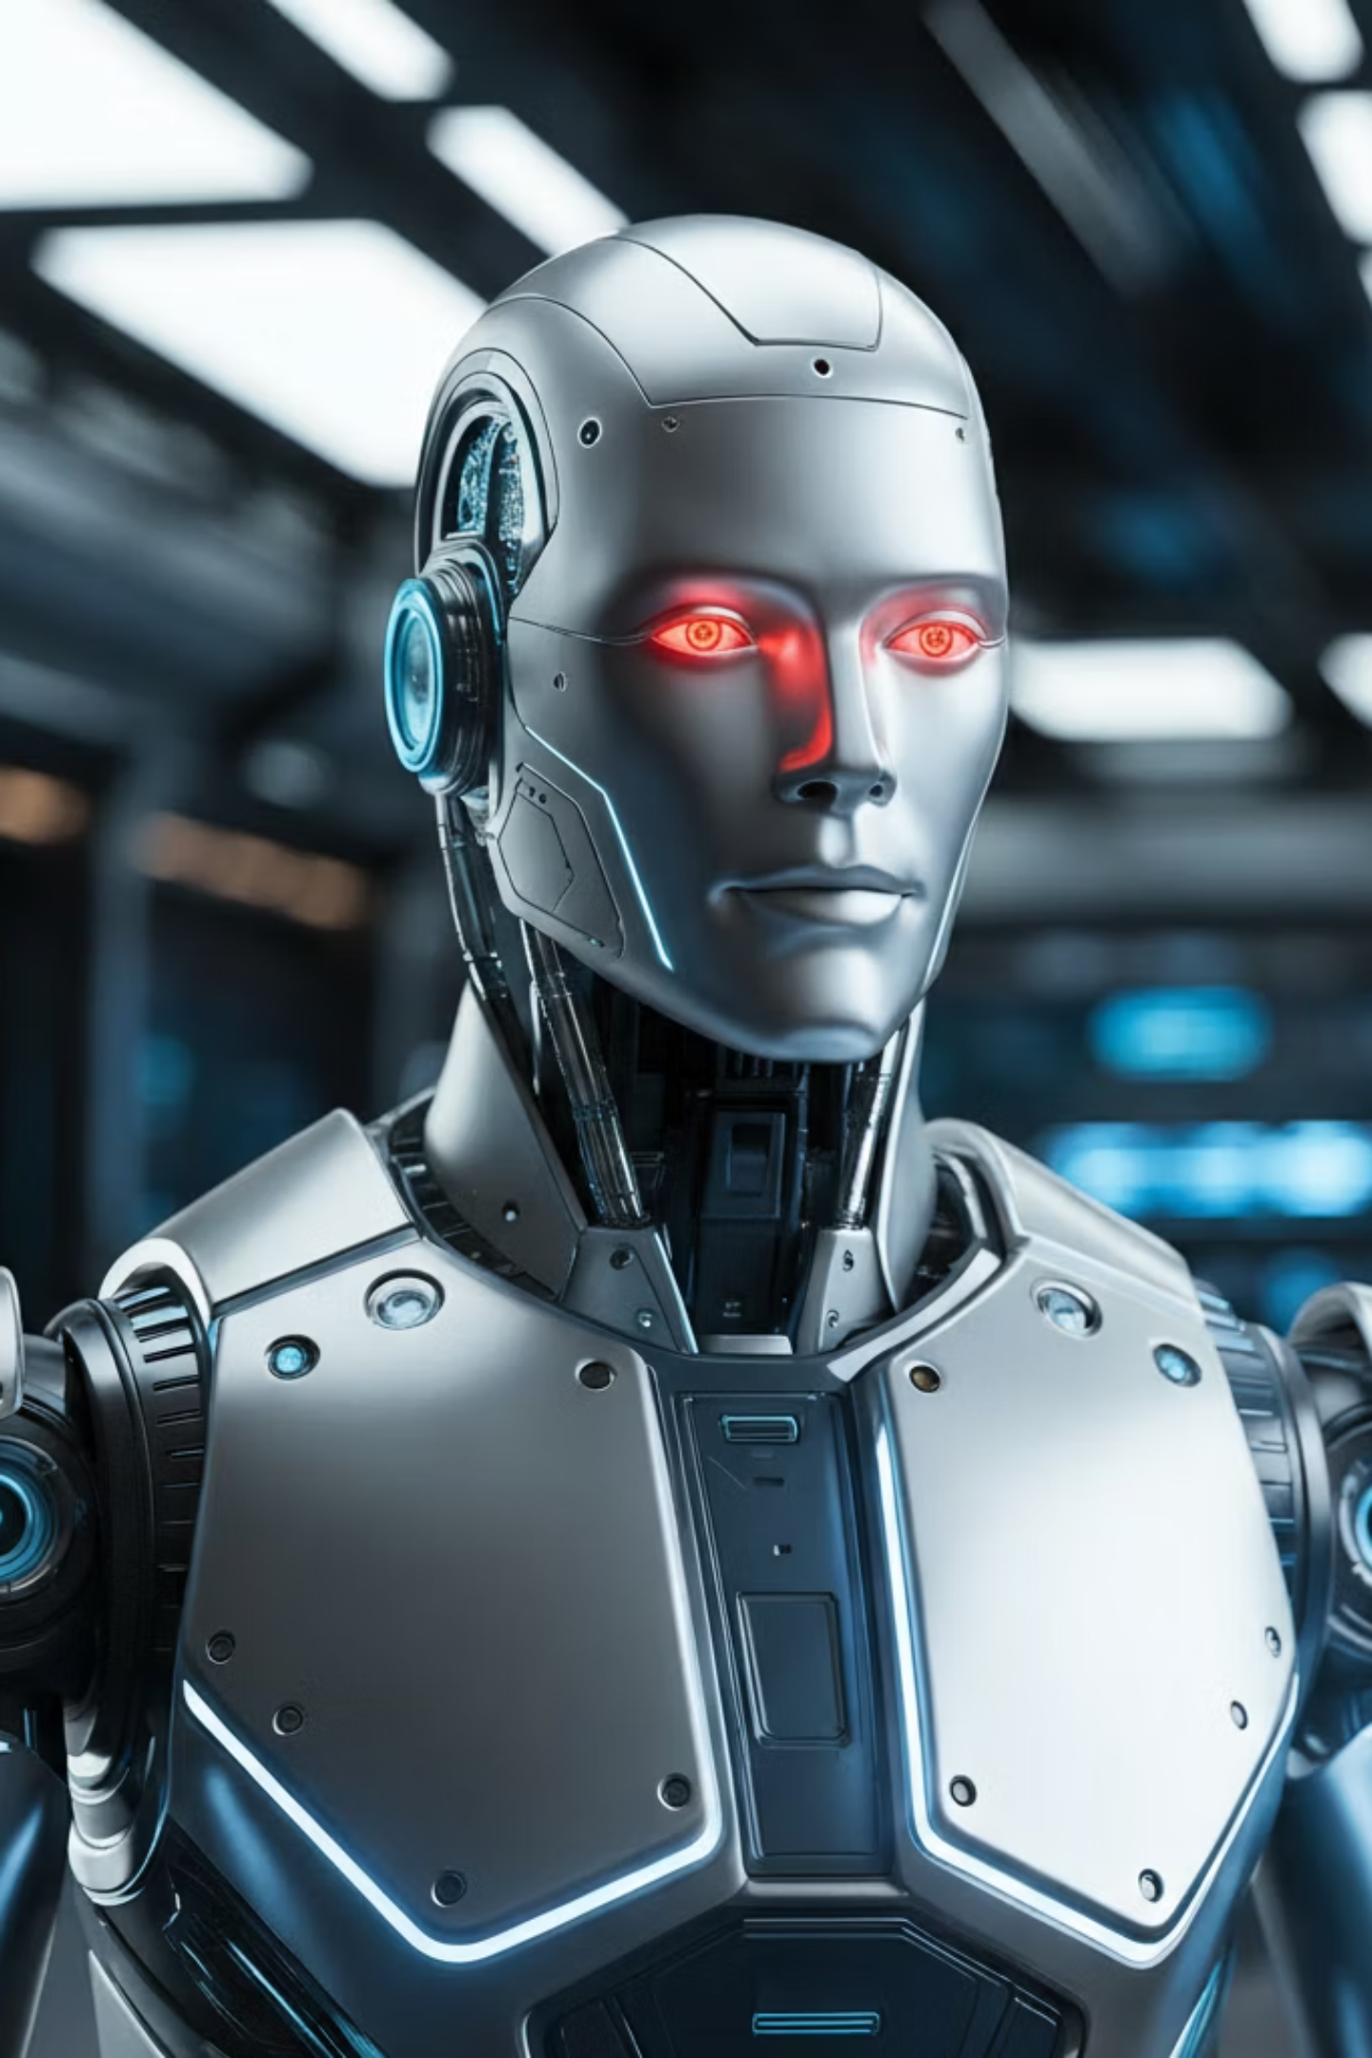

Human-Robot Collaboration: Working Together for Tomorrow
Human-robot collaboration merges ingenuity with efficiency, driving advancements and solving complex challenges across various sectors.
Advanced Manufacturing
Cobots boost productivity and safety, enabling precise tasks in manufacturing lines.
Transformative Healthcare
Robots aid medical professionals in surgeries, diagnostics, and monitoring, freeing staff for critical decisions and empathetic care.
Enhanced Daily Life
AI assistants and robots streamline household tasks, improve accessibility, and enhance daily convenience.

Slide 12
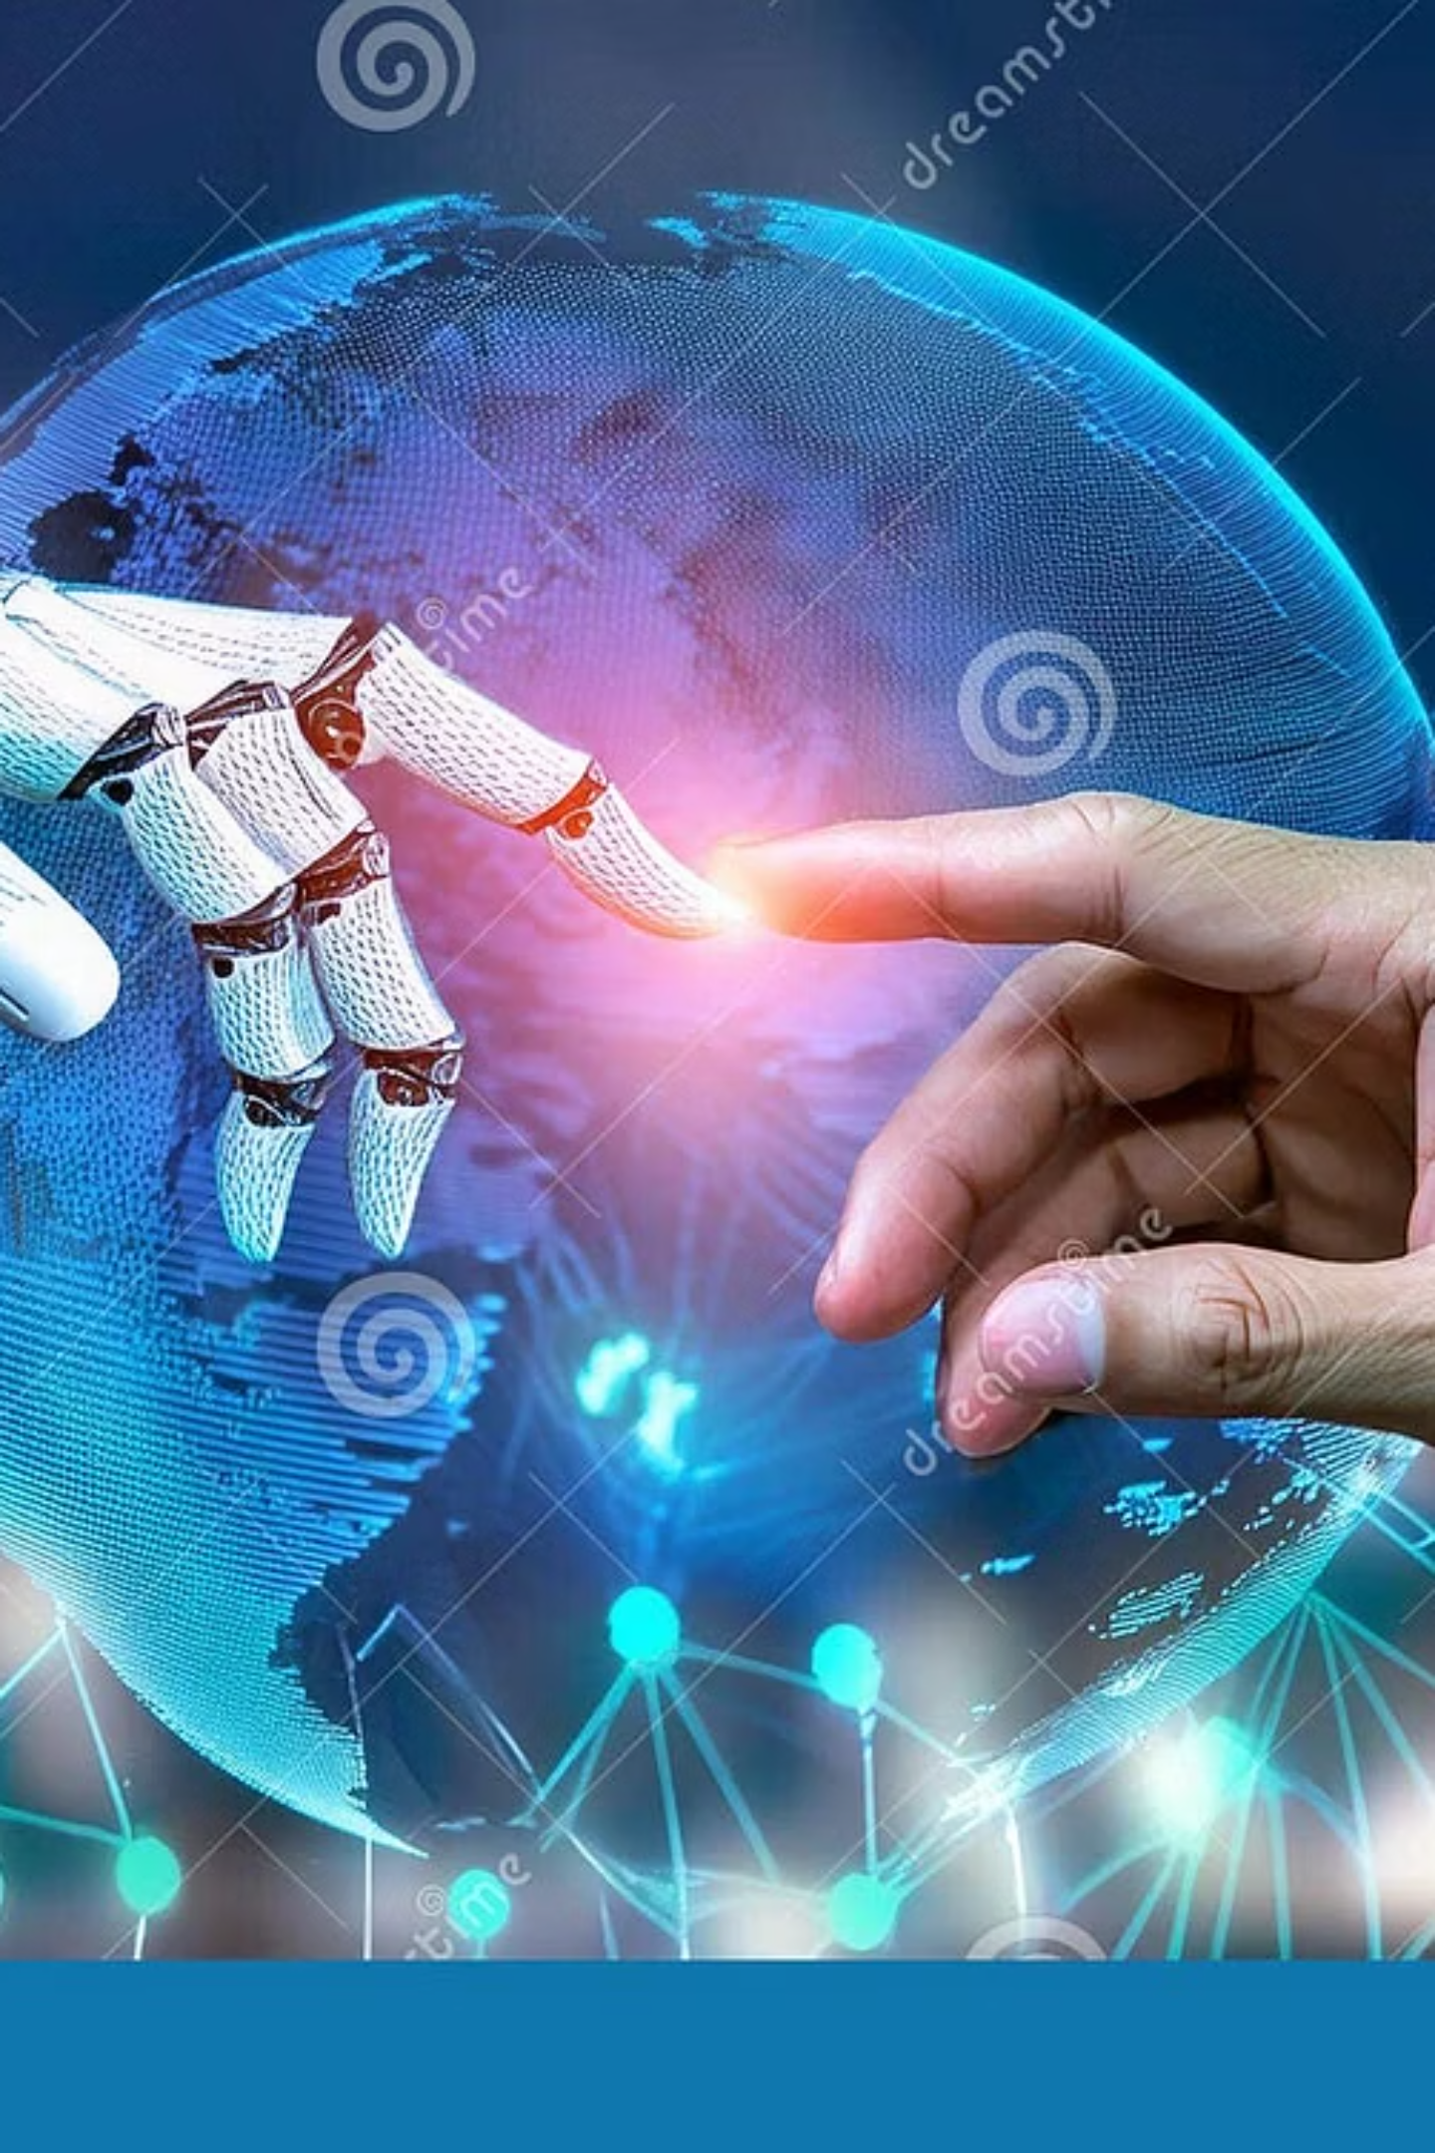
Thank You….
AI won't replace humans, but humans who use AI will replace those who don't. Let's build a future of augmented possibilities.

